Slide 1
NewsHub
Duke dunes

Slide 2
Present By:
Ms. Kruti Shah(21012532006)
Mr. Tirth Shah(20012531031)
Guided By:
Prof. Hiten Sadani

Slide 3
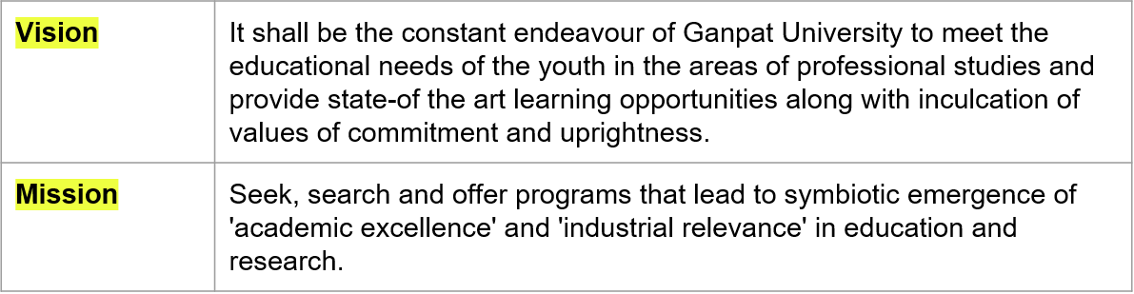
Vision and Mission of Ganpat University

Slide 4
Capstone Project - III Course Outcomes
After successful completion of this course, students will be able to:
CO1 Identify the problem by applying acquired knowledge
CO2 Analyze and categorize executable project modules after considering risks
CO3 Choose efficient tools for designing project modules
CO4 Combine all the modules through effective teamwork after efficient testing
CO5 Develop professional etiquette to work in a diverse team.
CO6 Integration and application of knowledge and skills acquired
CO7 Bring novel ideas into innovation
CO8 Technical report writing. Elaborate the completed task and compile the project report

Slide 5
Introduction
Duke Dunes News Hub is a forward-thinking web application designed to offer users an effortless and personalized news consumption experience. With a commitment to simplicity and user-centricity, our platform provides a distraction-free space where information is easily accessible, ad-free, and tailored to individual preferences.

Slide 6
Problem Statement
Challenges in News Consumption:
Information overload from various sources
Intrusive advertisements disrupting user experience
Complex interfaces leading to user dissatisfaction

Slide 7
Overcoming the Problem
Addressing Challenges with Duke Dunes
Streamlined news access from diverse sources
Ad-free environment ensuring distraction-free browsing
User-friendly interface for seamless navigation
Implementation of NLP-based summarization for concise news articles

Slide 8
Scope
Offering news from varied sources: Business, Science, Politics, Entertainment, etc.
Providing summarized news articles for quick comprehension
User customization options like trending news, favorite topics, and search functionality

Slide 9
Languages and Tools
Programming Languages: Python, HTML, CSS, JavaScript
Framework: Streamlit for web application development
Database: Google Firebase for storage
APIs: Google News RSS for news scraping, Newspaper3k for summarization

Slide 10
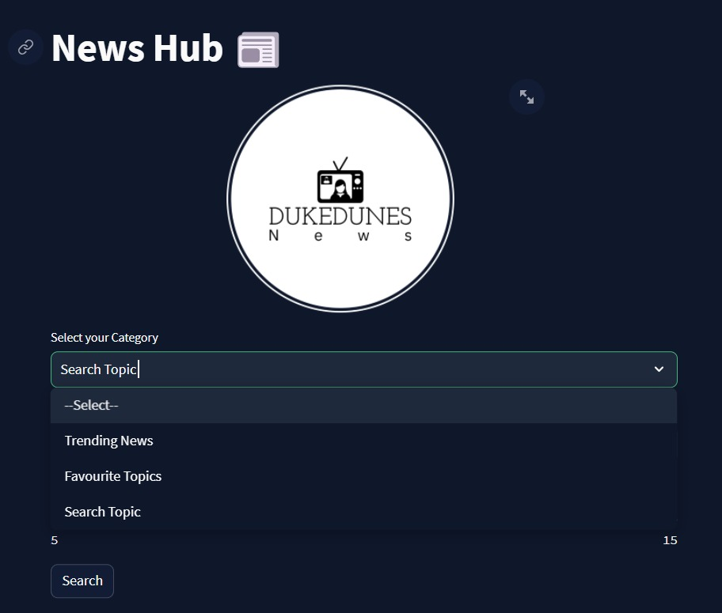
Features
Trending News: Highlighting popular topics
Favorite Topics: Allowing users to mark preferences
Search News: Enabling users to find specific articles

Slide 11
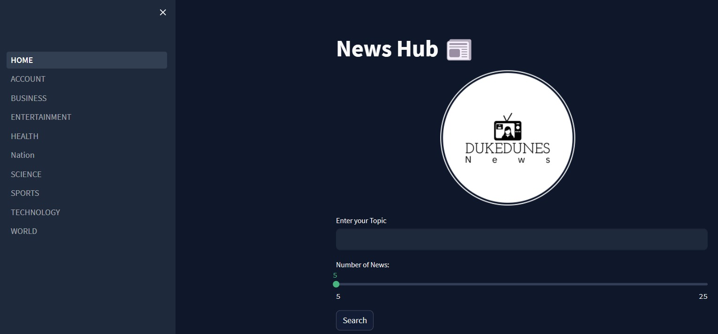
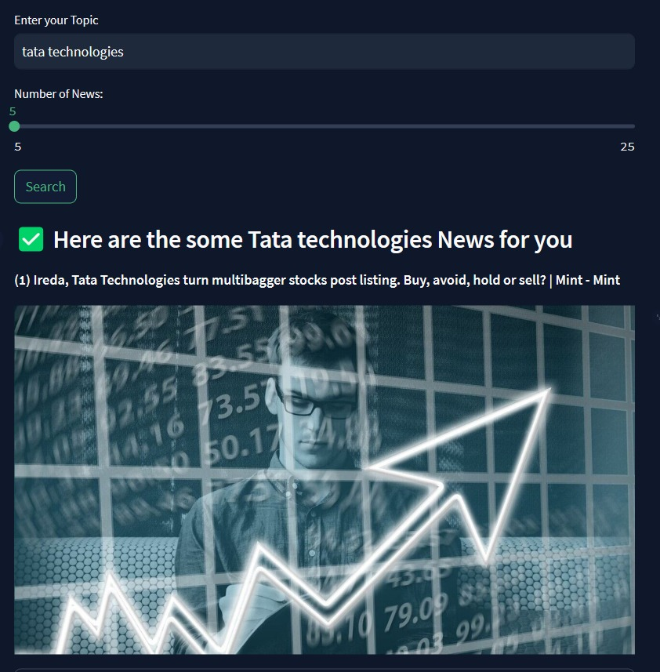
Implementation
Home Page: A clean interface for news access
Search Engine: A user-friendly search feature

Slide 12
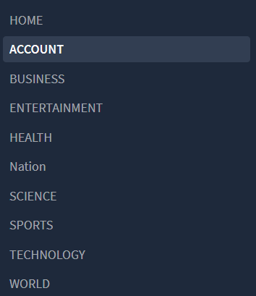
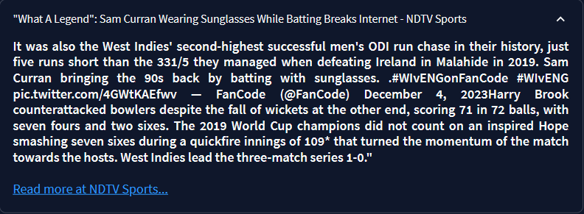
Implementation
Recommended News Sections: Business, Entertainment, Health, etc.
News Summarization: Example summaries and their interface

Slide 13
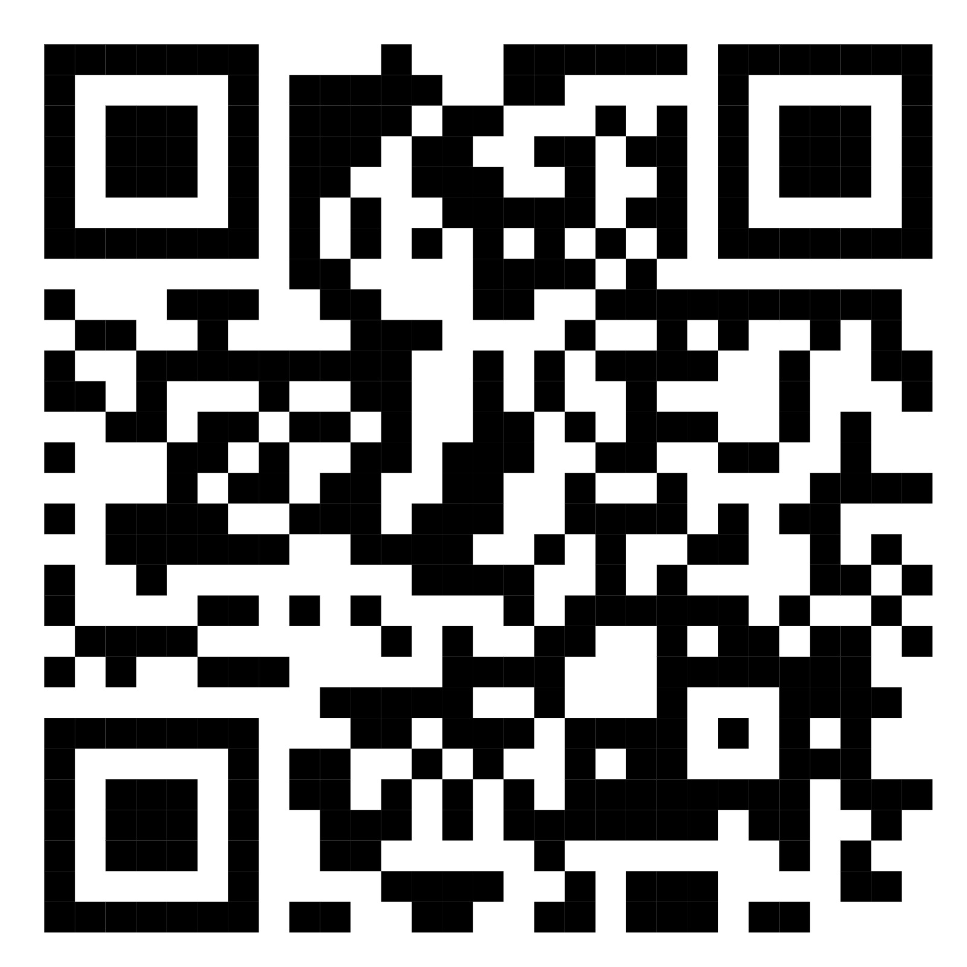
QR Code of Our Project

Slide 14
Thank You

